Slide 1
WORKSHOP
pygame

Slide 2
BATTLE TANK
SHOOTING GAME

Slide 3
TEAM NAME:
s cube
TEAM NUMBER:
26

Slide 4
Team members
sanjay.j
samuvel.s
sai BGM hemamalini

Slide 5
`
ACADAMIC MENTOR:
Mr.RAJASEKARAN
Dept of .IT.KITE

Slide 6
INDUSTRY MENTOR: MR
INDUSTRY MENTOR: Ms.Subhashini.U
associate
KG gss

Slide 7
ABSTRACT
BATTLE TANKER
This project is based on battle tank in war.It is a python game with graphics and user interaction.It is a basically battle game and it has two player controlled by keyboard actions .It has shooting function tankers have bombing functionality manyobjective of each player by shooting other tank.And make them every cause one life for user but the life are limited

Slide 8
In battle tank the toughness of the will be increased Once the certain score is reached then the player will move to next stage.
Once the player lost he will reappear for three time because in this game you have three life. In this game we can improve our speed because tanker will be moving speeder than you .This game is easily playable .It is an 2d game .

Slide 9
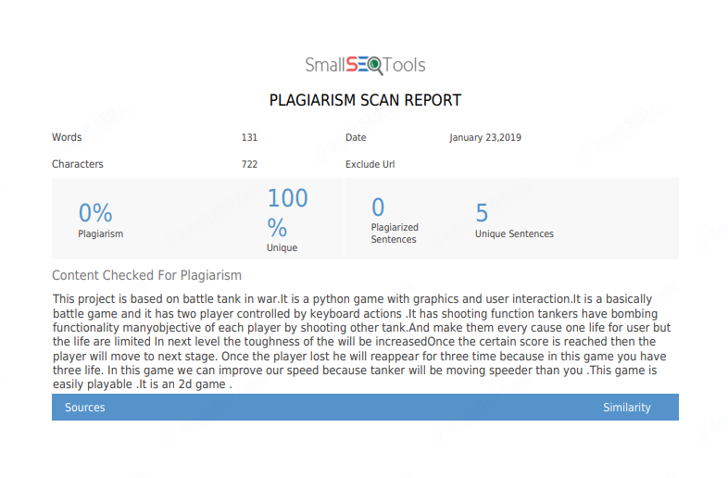

Slide 10
MODULES
One vs one
Two players will face each other.
The single player will attack the opponent differentiated than the other tanker.
The each players have three life.
In this both players will be in green color.
In this game the tanks will move faster .

Slide 11
MODEL ARCHITECTURE
START THE GAME
ONE VS ONE BATTLE
TWO PLAYERS
SHOOTING GAME
END THE GAME

Slide 12
REQUIREMENT THONNY LANGUAGE PYTHON
REQUIREMENT:
HARDWARE:
pentium4
SOFTWARE:
thonny
LANGUAGE:
python program

Slide 13
Statement:
we developed the simple tanker battle game using python programming
:

Slide 14
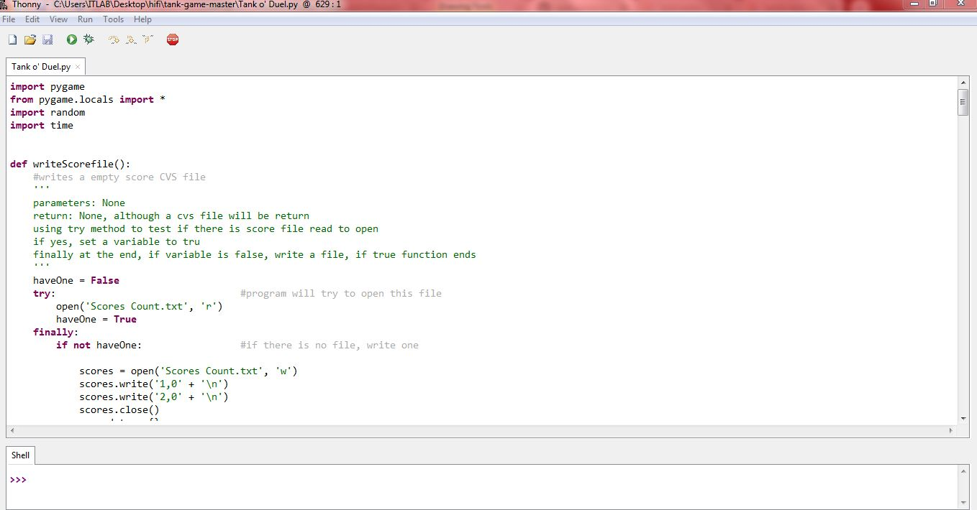
SOURSE CODE

Slide 15
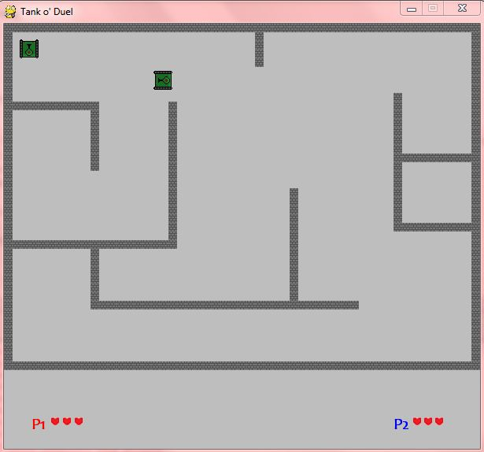
PYGAME(SCREEN SHOT)

Slide 16
FEATURES:
FEATURES:
interactive game
one vs one
arena

Slide 17

THANK YOU

